Slide 1

Olympic Games Data Analysis
Summer Olympics (1976 – 2008)
Created using Power BI

Slide 2
Project Overview :
Built an end-to-end Olympic analytics dashboard using Power BI
Analyzed medal distribution from 1976 to 2008 Summer Olympics
Focused on countries, athletes, sports, and gender participation
Designed for business-style reporting and insights

Slide 3
Dataset Description :
Covers all medal winners from:
1976 Montreal to 2008 Beijing
Key columns:
Year, Country, Sport, Discipline, Event
Athlete, Gender, Medal
Includes Gold, Silver, and Bronze medals

Slide 4
Key Performance Indicators
🏅 Total Medals: 15,316
🥇 Gold Medals: 5,042
🥈 Silver Medals: 5,016
🥉 Bronze Medals: 5,258
👥 Total Athletes: 11,337

Slide 5
Dashboard Features
Interactive slicers:
Year, Country, Sport, Discipline, Event, Medal
Country-wise medal comparison (Gold / Silver / Bronze)
World map visualization for geographic insights
Athlete-level medal analysis

Slide 6
Key Analytical Insights
United States leads overall medal count
Athletics and Aquatics have highest athlete participation
Male athletes won a higher share of medals
Certain countries dominate specific sports consistently

Slide 7
Tools & Skills Used
Power BI
Data cleaning and transformation
DAX measures and calculations
Data modeling
Dashboard design and storytelling

Slide 8
Business & Analytical Value
Enables quick comparison across countries and sports
Identifies top-performing nations and disciplines
Supports data-driven storytelling
Demonstrates real-world BI reporting skills

Slide 9
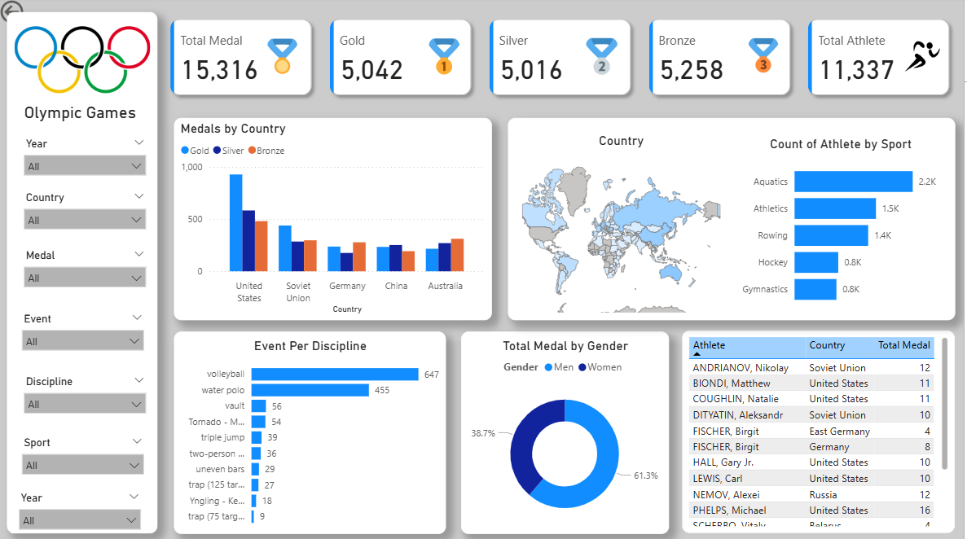
Dashboard

Slide 10
Conclusion
Successfully built a professional Power BI dashboard
Demonstrates strong analytical and visualization skills
Suitable for Data Analyst / BI Analyst portfolios
Can be enhanced further with advanced analytics

Slide 11
Thank You

